Slide 1
POWER POINT PRESENTATION
THE BIZCAM Management consultation report
Your name
Major
ID Number
경영학과
홍길동
20171234

Slide 2
POWER POINT PRESENTATION
Major
ID Number
경영학과
THE BIZCAM Management consultation report
20171234
PowerPoint is a computer program created by Microsoft Office
Enjoy your stylish business and campus life with BIZCAM
○ ○ 대학교 경영학과 20171234 홍 길 동

Slide 3
CONTENTS. A 75%
CONTENTS. A 75%
컨텐츠에 대한 내용을 적어요
Enjoy your stylish business and campus life with BIZCAM
컨텐츠에 대한 내용을 적어요
Enjoy your stylish business and campus life with BIZCAM
POWER POINT PRESENTATION
Microsoft Office PowerPoint is the presentation program used the most in the world.
You can use a software program such as Microsoft Power Point to provide the audience with slides that contains your major points or essential information.

Slide 4
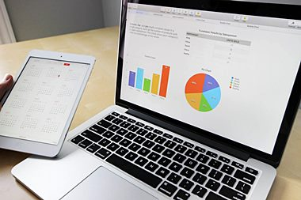
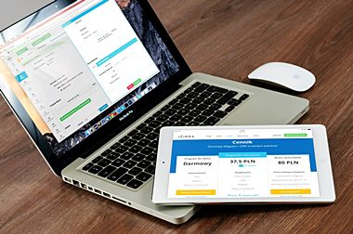
CONTENTS. A 72%
컨텐츠에 대한 내용을 적어요
Enjoy your stylish business and campus life with BIZCAM
컨텐츠에 대한 내용을 적어요
Enjoy your stylish business and campus life with BIZCAM
POWER POINT PRESENTATION
POWER POINT PRESENTATION
72%
Microsoft Office PowerPoint is the presentation program used the most in the world.
You can use a software program such as Microsoft Power Point to provide the audience with slides that contains your major points or essential information.
CONTENTS A
Microsoft Office PowerPoint is the presentation program used the most in the world.

