Slide 1
POWER POINT PRESENTATION
Enjoy your stylish business and campus life with BIZCAM
CONTENTS
POWER POINT PRESENTATION
3C Analysis
SWOT Analysis
4P Mix
IMC
ㅇㅇ대학교 경영학과 20171234
홍길동
Expected effect
Budget & Schedule

Slide 2
CONTENTS

Slide 3
CONTENTS A
컨텐츠에 대한 내용을 적어요
Enjoy your stylish business and campus life with BIZCAM
PowerPoint is a computer program created by Microsoft Office
Microsoft Office PowerPoint is the presentation program
used the most in the world.
You can use a software program such as Microsoft Power Point to provide the audience with slides that contains your major points or essential information.
CONTENTS
CONTENTS A
컨텐츠에 대한 내용을 적어요
Enjoy your stylish business and campus life with BIZCAM
CONTENTS A
컨텐츠에 대한 내용을 적어요
Enjoy your stylish business and campus life with BIZCAM

Slide 4
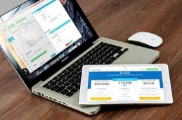
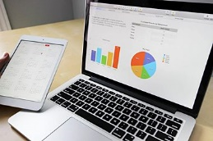
CONTENTS A
컨텐츠에 대한 내용을 적어요
Enjoy your stylish business and campus life with BIZCAM
CONTENTS
CONTENTS A
컨텐츠에 대한 내용을 적어요
Enjoy your stylish business and campus life with BIZCAM
Microsoft Office PowerPoint is the presentation program used the most in the world.
You can use a software program such as Microsoft Power Point to provide the audience with slides that contains your major points or essential information.
CONTENTS A
컨텐츠에 대한 내용을 적어요
Enjoy your stylish business and campus life with BIZCAM
CONTENTS. A
75%

