Slide 1
POWER POINT PRESENTATION
성명
까칠한 조땡, 조현석
한국대학교 경영학과 20170123
마케팅학원론 A Class 1조, 홍길동 교수님
START PRESENTATION
마케팅학원론 A Class 1조,
홍길동 교수님

Slide 2
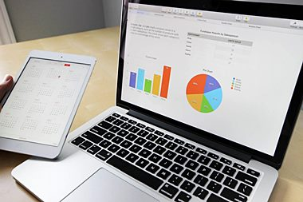
POWER POINT PRESENTATION
1/10
Enjoy your stylish business and campus life with BIZCAM.
◀ CONTENTS
컨텐츠에 대한 내용을 적어요
PowerPoint is a computer program created by Microsoft Office
CONTENTS
컨텐츠에 대한 내용을 적어요
PowerPoint is a computer program created by Microsoft Office
PowerPoint is a computer program created by Microsoft Office

